Slide 1
Probability
Definition of Probability

Slide 2
Probability of an Event
What do we mean when we make the statement “Ali will probably win the tennis match,” or “I have a fifty-fifty chance of getting an even number when a die is tossed,” or “The university is not likely to win the football game tonight,” or “Most of our graduating class will likely be married within 3 years”? In each case, we are expressing an outcome of which we are not certain, but owing to past information or from an understanding of the structure of the experiment, we have some degree of confidence in the validity of the statement.
we consider only those experiments for which the sample space contains a finite number of elements. The likelihood of the occurrence of an event resulting from such a statistical experiment is evaluated by means of a set of real numbers, called weights or probabilities, ranging from 0 to 1.

Slide 3
Definition: If an experiment can result in any one of N different equally likely outcomes, and if exactly n of these outcomes correspond to event A, then the probability of event A is P(A) = n/ N .
Example 2.24: A coin is tossed twice. What is the probability that at least 1 head occurs
Solution: The sample space for this experiment is
S = {HH, HT, TH, TT}. If the coin is balanced, each of these outcomes is equally likely to occur.
Example 2.25: A die is loaded in such a way that an even number is twice as likely to occur as an odd number. If E is the event that a number less than 4 occurs on a single toss of the die, find P(E).

Slide 4
Example 2.26: In Example 2.25, let A be the event that an even number turns up and let B be the event that a number divisible by 3 occurs. Find P(A ∪ B) and P(A ∩ B).
Solution: For the events A = {2, 4, 6} and B = {3, 6}, we have A ∪ B = {2, 3, 4, 6} and A ∩ B = {6}

Slide 5
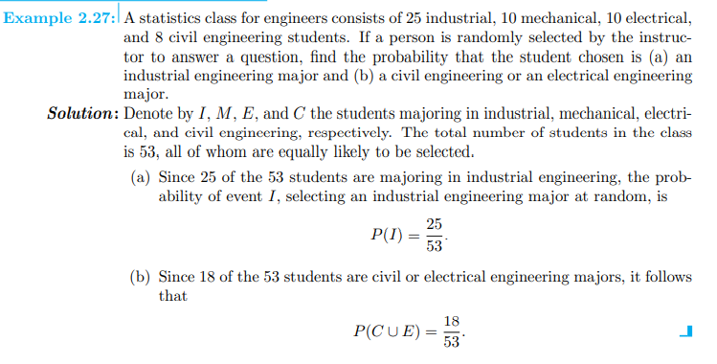

Slide 6
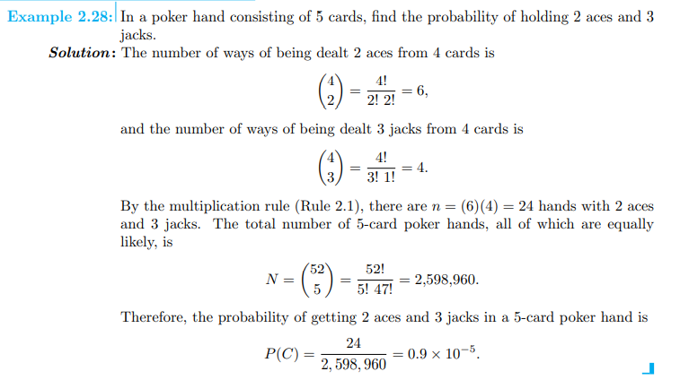

Slide 7
Example. If a card drawn from an ordinary deck of 52 playing cards, find the
probability that (i) the card is red (ii) the card is a diamond (iii) the card is 10.
Solution. The total number of possible outcomes is 52, and we assume that all
possible outcomes are equally likely.
Let A be the event that the card drawn is a red card.
m=n(A)= 26 n= 52 P(A)=26/52=1/2
(ii) Let B be the event that the card drawn is a diamond.
m=n(B)=13, n=52, P(B)=13/52= 1/4
(iii) Let C be the event that a card drawn is a 10.
m=4, n=52, P(C)= 4/52= 1/13

Slide 8
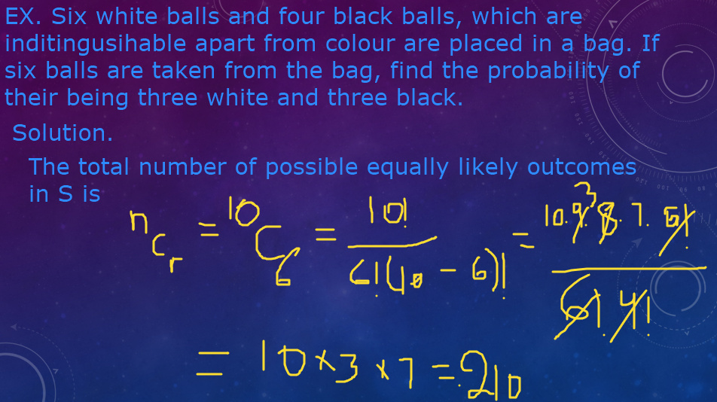

Slide 9
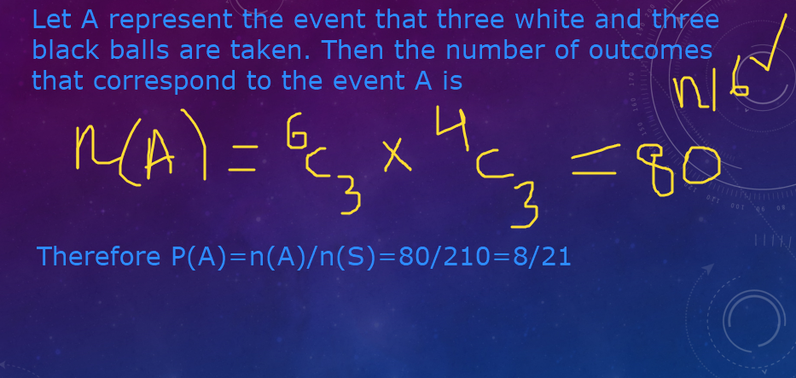

Slide 10
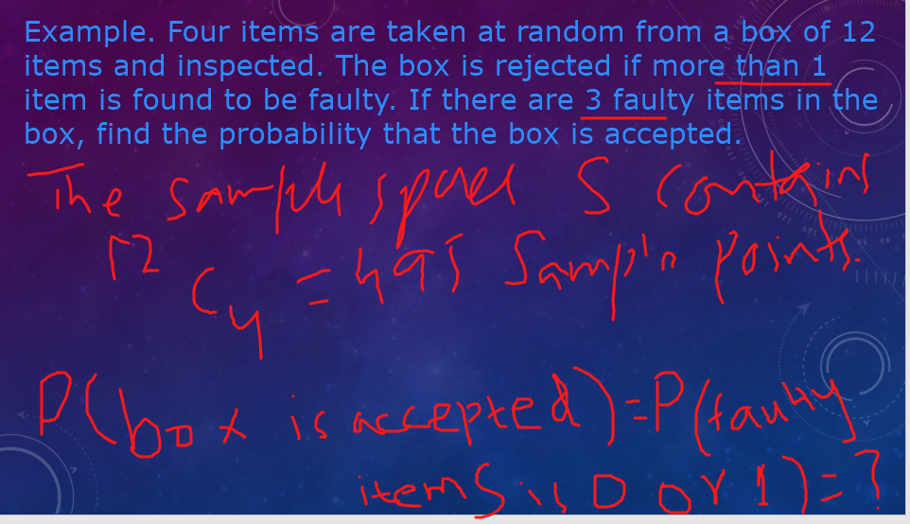

Slide 11
